Slide 1
SALTER-HARRIS (Epiphyseal injuries)

Slide 2
Introduction
DEFINITION
These are injuries occurring in bone ends where the epiphyseal growth plate has not closed.
They involve the epiphysis, metaphysis and the epiphyseal growth plate

Slide 3
CLASSIFICATION
TYPE I (Salter Harris I)
Complete separation of epiphysis at the growth plate without damage to metaphysis or epiphysis
TYPE II(Salter Harris II)
There is displacement of the epiphysis with a triangular fragment of the metaphysis attached to the displaced epiphysis
It is the commonest type

Slide 4
Cont.
TYPE III(Salter Harris III)
Displacement with fracture of the epiphysis or separation of articular surface with separation of epiphyseal fragment
TYPE IV(Salter Harris IV)
Fracture of the articular surface with extension across the growth plate into metaphysis
TYPE V(Salter Harris V)
Compression fracture involving part or all of the growth plate
Most severe form since its associated with arrested bone growth

Slide 5
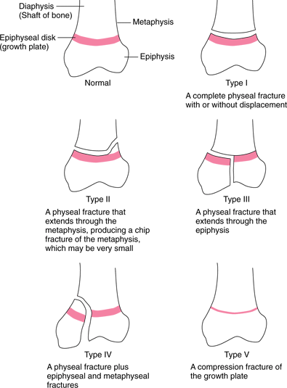
Salter Harris injuries

Slide 6
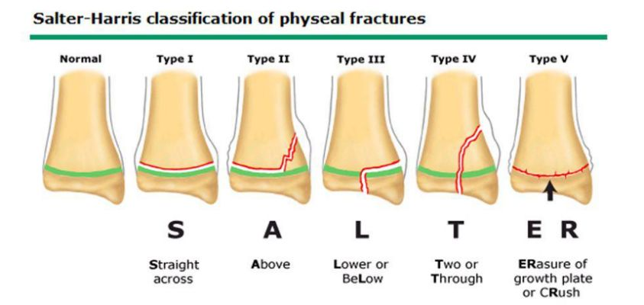

Slide 7
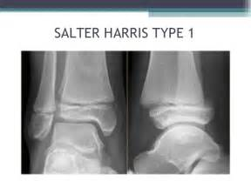
Salter Harris type I

Slide 8
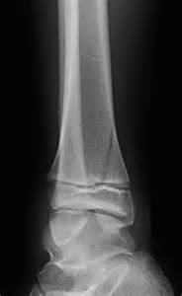
Salter Harris type II

Slide 9
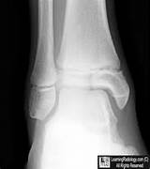
Salter Harris III

Slide 10
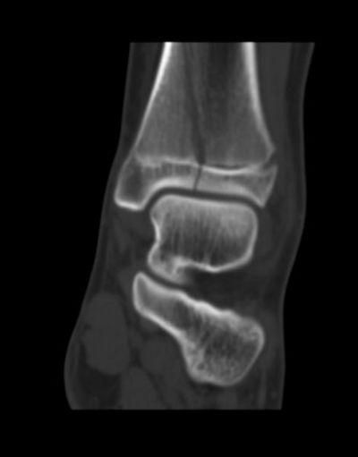
Salter Harris IV

Slide 11
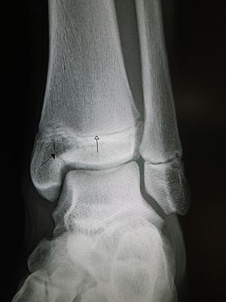
Salter Harris V

Slide 12
TREATMENT OF SALTER HARRIS INJURIES
Type I
Gentle manipulation.
If successful, immobilize with POP for 4 weeks
Type II & III
First try closed manipulation; if successful immobilize with POP for 4 weeks
If it fails, open reduction with internal fixation with a screw

Slide 13
Cont.
Type IV
Open reduction with internal fixation with screws
Type V
Gentle manipulation
Open reduction if manipulation fails
NB: It is very difficult to correct and associated with arrested bone growth

